Slide 1
Department of Electronics and Communication Engineering, VNIT Nagpur
Mini Project Submission
For
ECL 423: Image Analysis and Computer Vision
(Academic Year: 2023-24)

Slide 2
OBJECT SIZE MEASUREMENT USING OPENCV
Somuri Rohitha (BT20ECE097)
Baddam Pranvitha (BT20ECE010)
Topic Based on the Research Paper:
S. Anjanayya, S. P. Sai, S. S. Vardhan, S. Vivek, A. Vaishnavi and V. Ashwanthi, "Object size measurement using open CV (Computer Vision)," 2023 International Conference on Research Methodologies in Knowledge Management, Artificial Intelligence and Telecommunication Engineering (RMKMATE), Chennai, India, 2023.

Slide 3
Contents
Introduction
Motivation
Methodology
Results
Challenges
Conclusion

Slide 4
Introduction
What is Object Size Measurement
Object Size Measurement is determining the dimensions (length, width, height) of objects.
It's crucial for various applications such as manufacturing, quality control, and scientific research.
Introduction to openCV
OpenCV is an open-source computer vision and machine learning software library.
It provides tools and functions to perform image processing tasks, including object detection and measurement.

Slide 5
Introduction
Using OpenCV for Object Size Measurement
OpenCV offers several methods for object size measurement:
Image processing techniques (e.g., edge detection, contour analysis)
Feature extraction algorithms
Camera calibration for accurate measurements
These methods can be customized based on specific requirements and applications.

Slide 6
Motivation
These are some aspects which motivated us to take this project,
Quality Control: Ensure products meet standards by verifying dimensions during manufacturing.
Cost Efficiency: Automate quality control processes to save time and reduce errors.
Process Optimization: Improve productivity by analyzing measurements to optimize production parameters.
Biomedical Applications: Aid in disease diagnosis and treatment planning by measuring cells and tissues.
Automated Inspection: Detect deviations from standard sizes in real-time on assembly lines.

Slide 7
Motivation
Safety and Security: Enhance public safety by detecting and measuring objects in surveillance footage.
Education: Provide hands-on learning opportunities in computer vision and image processing.
Augmented Reality: Enhance user experiences by accurately measuring objects for AR applications.
Environmental Monitoring: Track changes in ecosystems by measuring objects in environmental images.

Slide 8
Methodology
Image Pre-processing:
Load the image and convert it to grayscale.
Apply Gaussian blur to smooth the image and reduce unnecessary edges.
Utilize the Canny edge detector for precise edge detection.
Perform morphological closing to eliminate noisy contours.
Object Segmentation:
Identify contours within the processed image.
Eliminate small contours based on a predefined area threshold (e.g., 100 pixels).
Arrange contours in a left-to-right order to identify reference objects.

Slide 9
Methodology
Reference Object Determination:
Calculate the pixel-to-metric ratio, assuming centimeters as the unit of measurement.
Results Computation:
Analyze and compute the dimensions of each segmented object.
Draw bounding boxes around the objects to visualize their positions and sizes.

Slide 10
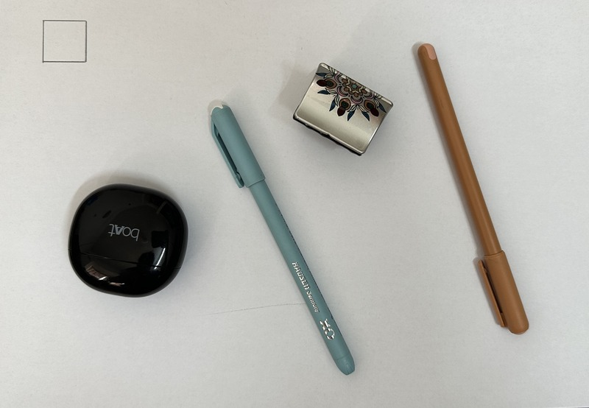
Results
Original image :

Slide 11
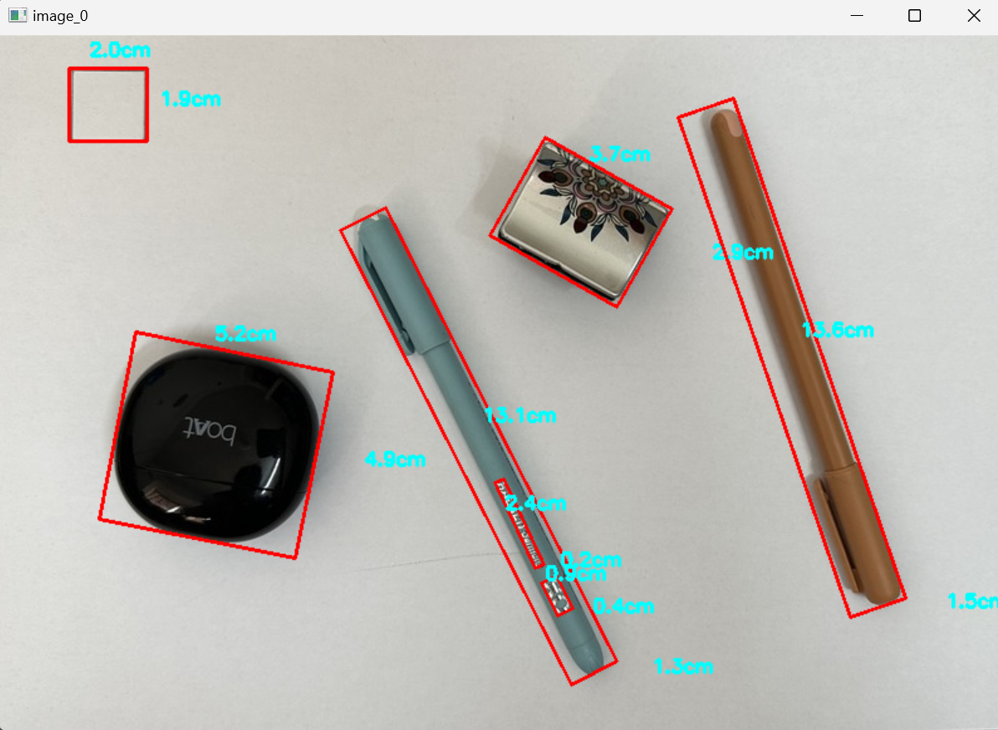
Results
Output :

Slide 12
Challenges
Lighting conditions, camera calibration, and image resolution can affect measurement accuracy.
Noise and occlusions may hinder object detection and contour analysis.
Proper preprocessing and algorithm selection are critical for reliable results.

Slide 13
Conclusion
Therefore, it can be concluded that this project demonstrates a comprehensive pipeline for object size estimation and segmentation through image processing techniques.
Techniques such as grayscale conversion, Gaussian blur, Canny edge detection, and morphological closing are employed for effective preprocessing, enhancing object detection accuracy while reducing noise.
Determination of reference objects facilitates accurate metric conversion, ensuring precise size measurements.
Our code is detecting and measuring minute details in object too.

Slide 14
References…
S. Anjanayya, S. P. Sai, S. S. Vardhan, S. Vivek, A. Vaishnavi and V. Ashwanthi, "Object size measurement using open CV (Computer Vision)," 2023 International Conference on Research Methodologies in Knowledge Management, Artificial Intelligence and Telecommunication Engineering (RMKMATE), Chennai, India, 2023, pp. 1-6, doi: 10.1109/RMKMATE59243.2023.10369151. keywords: {Computer vision;Shape measurement;Semantic segmentation;Quality control;Size measurement;Cameras;Real-time systems;Open cv;Stereo vision;Dimension calculation;Edge detection},

